Slide 1

RHP 9 “Raise the Floor”
PDSA Cycles Webinar #3
August 5, 2015

Slide 2
Webinar Housekeeping
For Attendance, please submit your name via the chat function located on the right hand side of your screen
Do not place phones on Hold, USE MUTE
During the presentation, you can submit your questions to the host through the chat box to the right of your screen.
This session is being recorded for the purpose of sharing information with others who could not attend.
Presentation and PDSA documents will be placed on the RHP 9 Webpage under Learning Collaboratives, Webinar

Slide 3
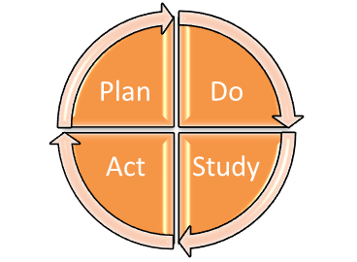
PDSA
Plan Do Study Act
Deming wheel / Shewhart cycle
Also PDCA (Plan-Do-Check-Act)
Systematic method for improvement
Iterative for continual improvement
Promotes small scale rapid cycle improvement over a short period of time
Avoids: Ready, Fire, Aim

Slide 4
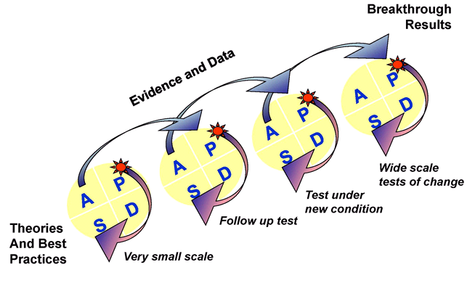
Model for Improvement
What are we trying to accomplish? (AIM)
  Plan: developing a plan to test the change
  Do: carrying out the test
  Study: observing and learning from the consequences
  Act: determining what modifications should be made to the test
How will we know that a change is an improvement? (MEASURE)
What change can we make that will result in improvement? (CHANGE)
Act
Plan
Study
Do
Reference: Langley, Nolan, Nolan, Norman, & Provost. The Improvement Guide
Notes:
Nolan’s model--three questions and PDSA, but not just one PDSA. Difference between this and Juran is the emphasis on repeated PDSA cycles

Slide 5
Presenters
PDSA – Forensic Diversion Unit
  Dallas County
  Charlene Randolph, CSP Project Manager
  Charlene.randolph@dallascounty.org
Medication Therapy Management
  Parkland Health & Hospital System
  Kristen Snackey Alvarez, PharmD, BCPS
    Sr. Clinical Pharmacy Specialist Hospitalist Service
    Assistant Professor Internal Medicine-Hospitalists
    Kristin.Alvarez@phhs.org
Every Girl Counts: PDSA Cycles to Increase HPV Series Completion in African American Girls
  Parkland Health & Hospital System
  Teresa Garry, RN
  Community Oriented Primary Care
  Teresa.garry@phhs.org
JPS Behavioral Health Integration Model
  JPS Health Network
  Chris Wall, RN-BC, BSN
  Behavioral Health Project Director
  cwall@jpshealth.org

Slide 6

Dallas County
1115 Waiver- DSRIP
Crisis Services Project (CSP)
Presentation:
PDSA- Forensic Diversion Unit
August 5, 2015
Charlene Randolph, CSP Project Manager
Charlene.randolph@dallascounty.org

Slide 7
Crisis Services Project (CSP)
Goal/ Who we Serve
CSP Goal:
Reduce higher levels of care and criminal justice involvement for persons with behavioral health needs
We serve:
Clients in jail with verified and suspected behavioral health needs*
Clients on forensic commitments to State Hospitals
*Most clients receive behavioral services within the North Star network

Slide 8
Crisis Services Project (CSP)
Improving Clients Outcomes
CSP Improves Client Outcomes by:
Getting early referrals (at book-in)
Repeating engagements while client is in jail
Recognizing treatment recommendations are significantly influenced by readiness to change
Facilitating early collaboration to develop exit plans
Identifying client and system barriers early (housing, financial
transportation)
Developing tailored re-entry responses
Recognizing Trauma-informed care as a system response

Slide 9
Crisis Services Project (CSP)
Forensic Diversion Unit (FDU) Overview
Forensic Diversion Unit (FDU)
Created to Serve persons:
Not eligible for ACT (lacks hospitalizations) but needs ACT level
Criminal Justice frequent flyers
Potential threat to the community if they decompensate
Not eligible for NorthStar
IDD issues, but does not qualify for IDD services
Traumatic Brain Injury
NorthStar eligible, but with trauma as primary service driver
NorthStar eligible, but with Axis II diagnosis as primary service driver
Complex medical issues
* Existing program funded by Dallas County
* Monitored and Facilitated by Metrocare Services

Slide 10
Crisis Services Project (CSP)
Forensic Diversion Unit- PDSA (1.0)
Issue 1: Dallas County was paying for the FDU program; however, there was little oversight to ensure the program was operating effectively and serving appropriate clients. There was little understanding how to make referrals to FDU, criteria was subjective, and some clients never moved off FDU.
Aim: Ensure appropriate clients are utilizing the FDU program and improve client outcomes
Test of change: Determine if aligned FDU program to CSP goal and processes improved client outcomes

Slide 11
Crisis Services Project (CSP)
Forensic Diversion Unit- PDSA (1.0)
Changes to FDU (Plan):
CSP now funds FDU and will provide administrative oversight for the program
Metrocare Services provides program implementation and is part of FDU team
Tasks to test change (Do):
Review if modified FDU management structure improved program
Determine if streamlined communication between Dallas County, Metrocare Services, and referring agencies improved
Determine if modification to rigid FDU service guidelines improved client impact (e.g. continued engagement/ payment for FDU in jail)
Determine if step down process improved client outcomes
Determine if refined referral process and criteria ensured appropriate clients

Slide 12
Crisis Services Project (CSP)
Forensic Diversion Unit- PDSA (1.0)
Prediction:
Aligning FDU to CSP goal and processes will help ensure appropriate clients are served by FDU, positively impact client outcomes, and increase the capacity for other potential clients to enter the program
Measures to determine success:
FDU enrolled at census (Goal: 45 clients)
All long-time (over 3 years) FDU clients receiving a clinical assessment to determine next steps in program (stay in FDU, step down to LLOC)
Streamlined process for FDU referrals
Development of process to allow continued FDU engagement in preparation for jail release (client can stay in FDU program even if re-incarcerated)
Develop formalized a step-down process

Slide 13
Crisis Services Project (CSP)
Forensic Diversion Unit- PDSA (1.0)
Results from changes (Study):
All referrals went through a centralized referral process√
Not all referrals were appropriate once they reached review team X
FDU census still below max (lowest- 34 clients enrolled) X
Not many referrals outside of Metrocare (even CSP referrals were minimal) X
Improved collaborative partnership between Dallas County and Metrocare Services √
All clients who had been or FDU more than 3 years was reviewed by clinical team for appropriateness √
Formalized a step-down process to increase client efficacy and increase independence in the community (staff begin to see them less and attempt to place people in lower services)√
Implanted care to begin while in jail in order to begin alliance and working relationship √
Formalize meetings to discuss types of appropriate referrals, inclusion and exclusion criteria, and other clinical difficulties √

Slide 14
Crisis Services Project (CSP)
Forensic Diversion Unit- PDSA (2.0)
Issue 2: The referral process to the Forensic Diversion Unit (FDU) wasn’t efficient, census numbers were below capacity, and data not in a central location
Aim (Plan): Improve FDU referral process and refine program criteria to improve client outcomes
Test of change (Do): Determine if modifications to the FDU referral process and criteria will help ensure timeliness of referrals and review process, and accuracy of census count

Slide 15
Crisis Services Project (CSP)
Forensic Diversion Unit- PDSA (2.0)
Prediction:
Redesign of the referral process and criteria review will ensure timely responses to referrals and appropriate utilization of FDU program
Measures to determine prediction:
Number of clients referred and reviewed by team within 2 business days
Number of referrals triaged for an assessment (minimum of 2 monthly referrals from CSP, Metrocare Services, Transicare, Adapt)
Number of clients enrolled (goal is 45 clients)
FDU program is centralized to monitor and provide updates on this information
* PDSA 2.0 still in Study and Act phases

Slide 16
Medication Therapy Management
Presented by:
KristIn Snackey Alvarez, PharmD, BCPS
  Sr. Clinical Pharmacy Specialist Hospitalist Service
  Assistant Professor Internal Medicine-Hospitalists
  Kristin.Alvarez@phhs.org
  AUGUST 5, 2015

Slide 17

Overview of Project
Inpatient
Admission Med Histories
Allergy Counseling
Outpatient
Diabetes
Technology
Educational Materials
PCN allergy testing
Post Discharge
ACE/ARBs/Diuretics
Workflow enhancements
Report building

Slide 18
Why?
New Service
No Method of Identification of Patients
Unaccounted for MTM services (Telephone Calls)
Many Epic Enhancements Needed

Slide 19
PLAN
Build New Visit Type and Navigator
Create MTM Referral
Track Number of Referrals and Office Visits

Slide 20
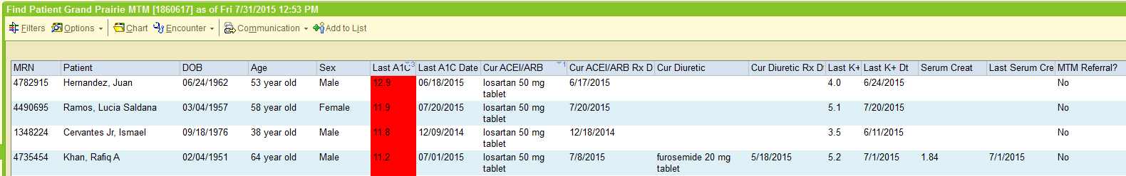
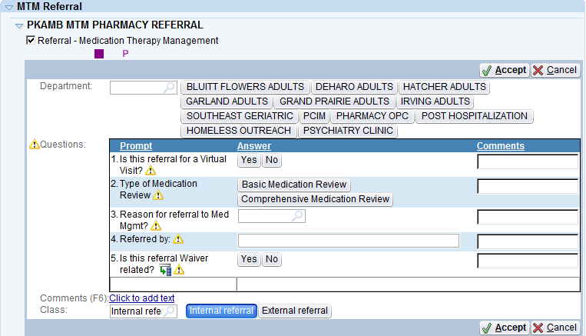
DO – Find Patients
Build RWB to Find patients with HgbA1c >9% and on Diuretics and ACE/ARB with no monitoring
Create MTM Referral

Slide 21
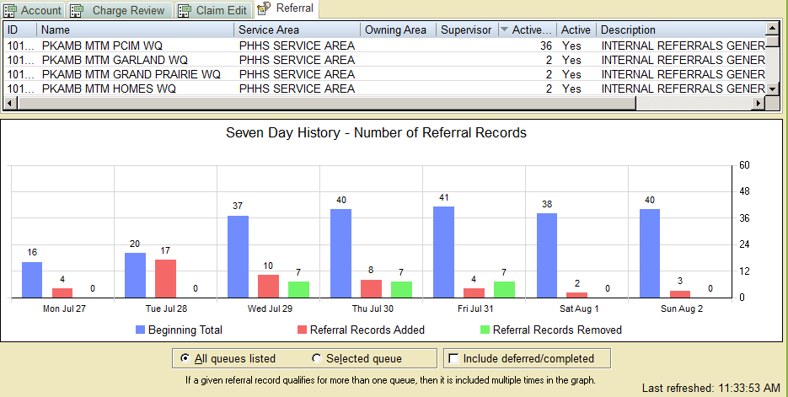
DO – Referral Workqueues
Easy access to see who was referred to MTM services

Slide 22
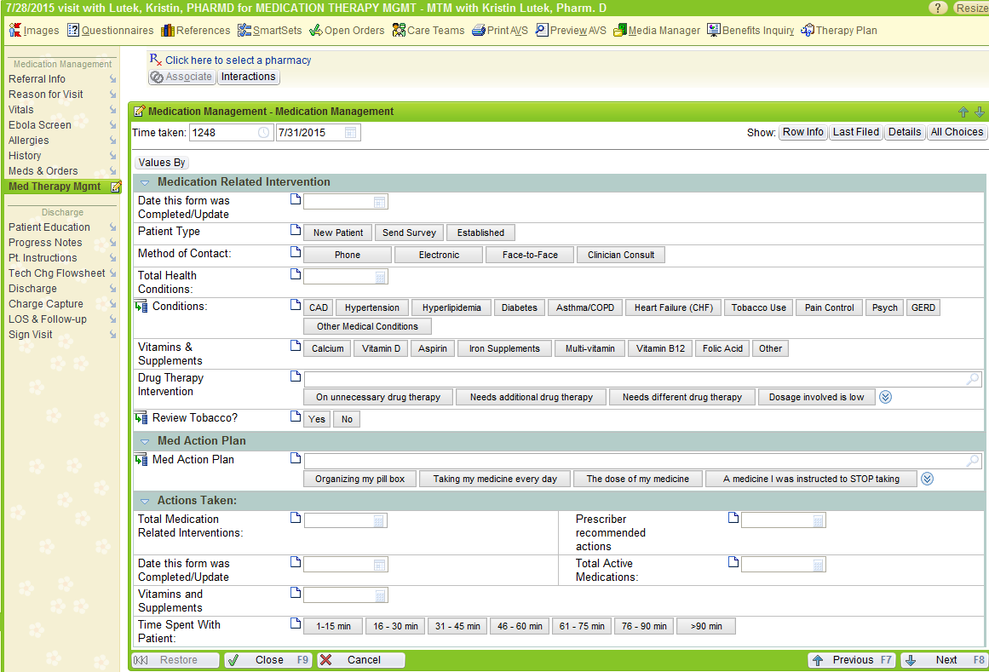
DO – Build New MTM Visit & Navigator
MTM services specific navigator
Detailed medication documentation
Detailed counseling & intervention documentation

Slide 23
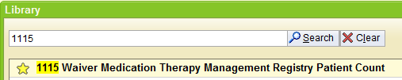

DO – Track Progress
Epic
Reporting

Slide 24
STUDY
*there is overlap in the individuals receiving MTM and Other OVs, these patients are only counted once in the cumulative patients

Slide 25
ACT
 | Result | Action
Scheduled Patients | Templates not full | New recruiting methods New Visit types
Missing Patients | Reporting workbench not catching all patients | Revise and compare with a clarity report
Referred Patients | Initial Spike | Encourage ongoing referrals for patients needing post d/c MTM services and chronic MTM services
Time spent to make appts | Time that could be spent seeing patients were used to make appointments | Change all post discharge appts to PAC scheduling

Slide 26
PLAN
Add in Pharmacy Visits other then MTM specific and Build a HOMES visit type
Start Tracking No Shows
Off load some inpatient discharge counseling to post discharge visits
Obtain MTM certification for each provider

Slide 27
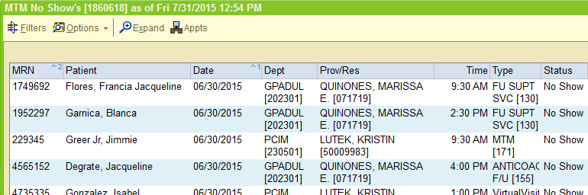
Do
Build RWB to track No Shows
Schedule all pharmacy consulted discharge patients (non TCU) for a follow up with discharge MTM services. Referral will route through PAC.
Report on other office visits (e.g., Anticoagulation, DM education, etc)
Add a HOMES workqueue to capture those patients
Schedule and attend MTM training sessions

Slide 28
STUDY
Metric Complete for DY4
*there is overlap in the individuals receiving MTM and Other OVs, these patients are only counted once in the cumulative patients

Slide 29
STUDY

Slide 30
ACT
 | Result | Action
No Shows | With PAC Scheduling there was a large decrease in Show Rate to visits | Evaluate reasons for No Shows Revise script used to describe MTM services for PAC
Preparation for DY5 | Will need to more than double the patient’s seen for DY5 | Education to outpatient pharmacists to refer patients encountered in pharmacy Plan to block out schedule for the beginning of DY5 in order to provide virtual services to the 400+ MTM registry enrolled patients
MTM training and compliance billing | Missing Medication Action Plans in AVS | Build MAP into the MTM navigator and build dot phrase so can be added into any note or d/c instructions

Slide 31
Continuous Improvement

Slide 32




Every Girl Counts: PDSA Cycles to Increase HPV Series Completion in African American Girls
RHP 9: Chronic Disease Registry to Improve Category 3 Measures
Presented by: Teresa Garry, RN
Community Oriented Primary Care
August 5, 2015

Slide 33
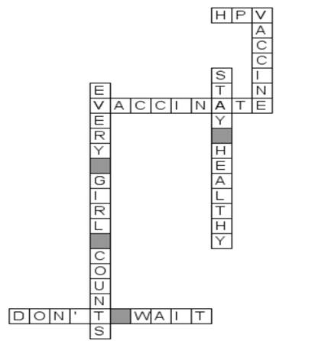
Storyboard
A 12 year old girl is identified as needing her third HPV dose. In the month of the her 13th birthday, there were failed attempts to make contact due to bad phone numbers. The chart revealed risk behaviors as well as drop off in primary care causing concern.
A home visit was conducted a day before her birthday, she was having her hair permed and couldn’t go to the clinic for her shot so the nurse administered the vaccine in her home. She is re-engaged in primary care.

Slide 34
HPV Vaccine - Background & Challenge
First cancer fighting vaccine
Despite it’s safety and effectiveness, completion rates are suboptimal
Series dose completion is a disparity indicator with only 14% of African American girls receiving the vaccine statewide
Acceptance of the vaccine is a challenge due to not being required for school, concerns for safety and effectiveness, fear of the promotion of early onset sexual activity and trust, communication issues with providers
Parkland is an active research partner in HPV vaccine research
      Developing a self-persuasion intervention promoting adolescent HPV vaccination: NIH\NCI Grant Funded; Fuller (Parkland Co-PI) & Persaud (Parkland Co-PI)

Slide 35
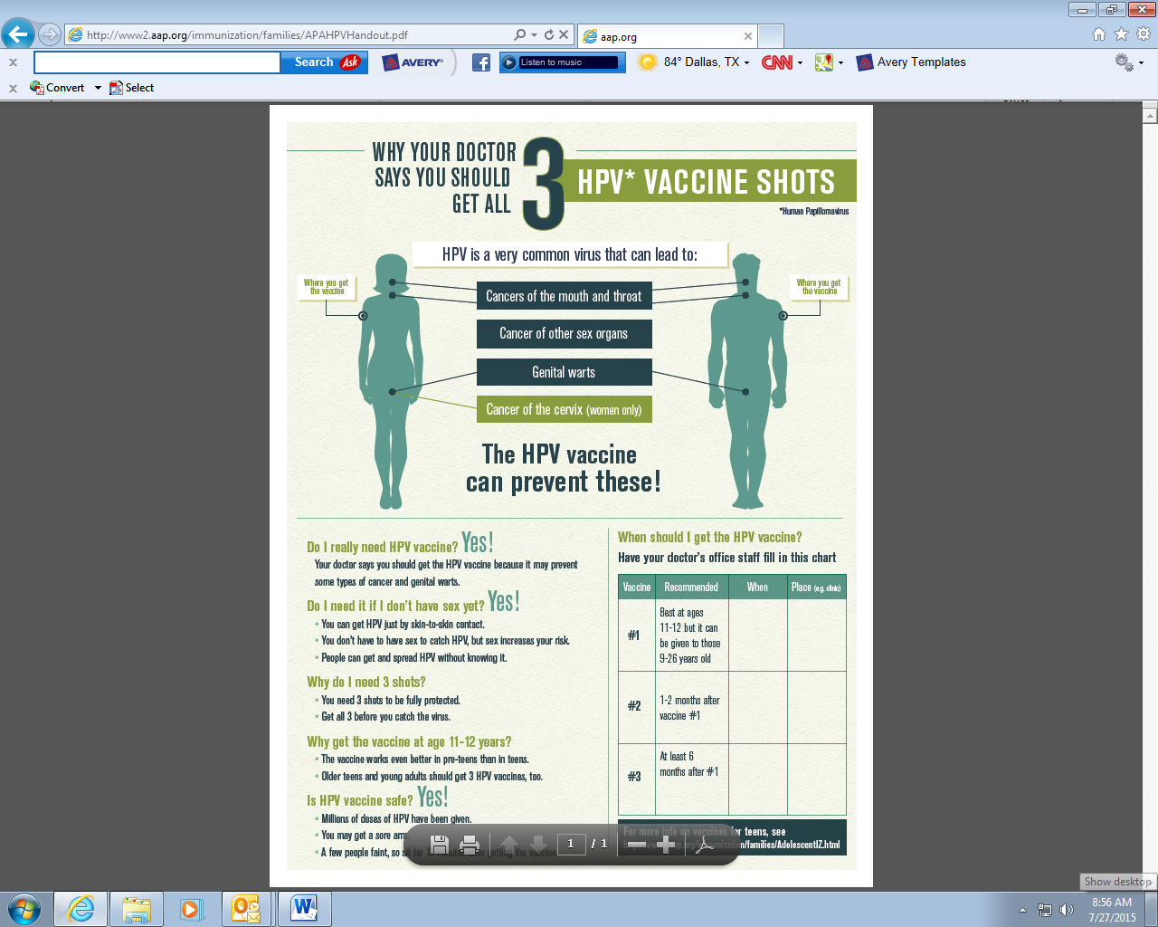
HPV Vaccine Dosing Interval Adds Complexity to Completion and Series Completion by a Specific Birthdate

Slide 36
PDSA Cycles Overview
Best practice alert (BPA) developed
Best practice alert (BPA) implemented
Staff educated
Reporting system developed
HPV due reports
Outreach for series completion
Education
Brainstorming
“Every Girl Counts” campaign
“Be Strong! Don’t Back Down” campaign
PDSA I
PDSA II
PDSA III
Target 18.3%
Baseline 14.87%
HPV Improvement Continuum
April
2014
October
2014
Feb - March
2015
June
2015
Baseline cohort defined. Baseline performance and target set

Slide 37
First PDSA Cycle - Plan
In April 2014, Parkland launched the first PDSA cycle to increase HPV series completion in African American Girls
PI Project Team Initiation: Medical Director, Nurse Director, Population Health Nurse, PI Project Manager
2013 Pediatric Quality Committee Endorses NQF 1959: Complete Series of 3 HPV by 13th Birthday
Baseline determined: 14.87% - Target set:18.3%
Electronic best practice alert development
Clinical Staff education
Registry build and report creation for:
      Cohort monitoring
      Monthly performance monitoring

Slide 38
First PDSA Cycle - Do
EHR best practice Go Live October 2014 for 11 and 12 year old African American Girls
Educated staff in order to raise awareness on the matter
Introduced patient education during individual visits

Slide 39
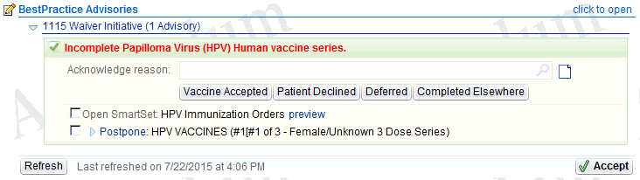
HPV Best Practice Alert

Slide 40
First PDSA Cycle - Study
Monitoring the impact of the education and BPA
Validating the performance measures

Slide 41
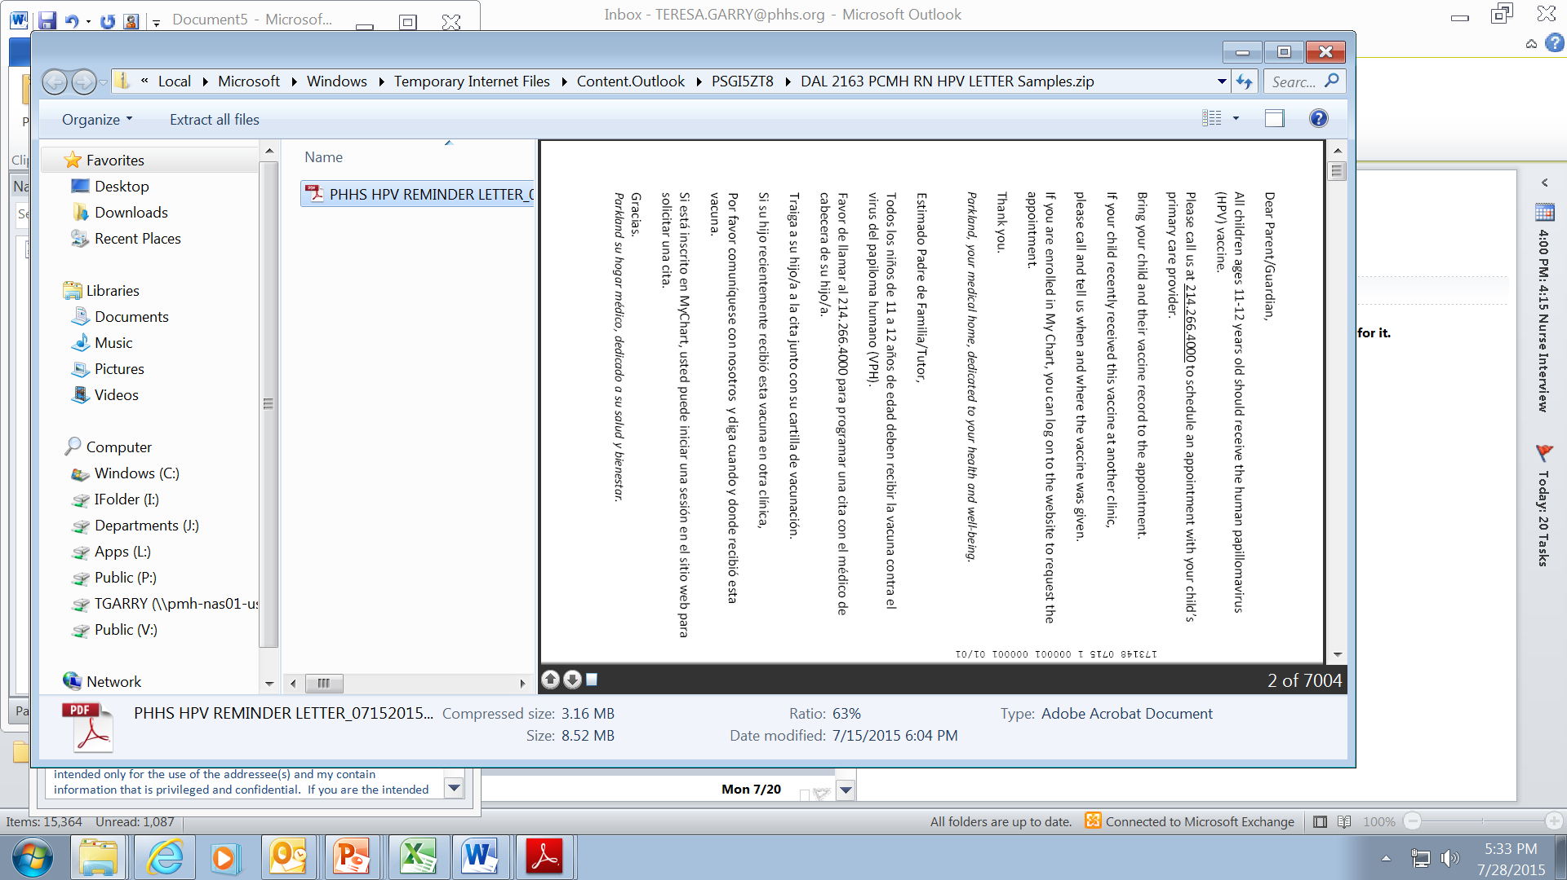

First PDSA Cycle - Act
Further initiatives to improve the project outcome:
  Introduce appointment reminder letters for patients

Slide 42

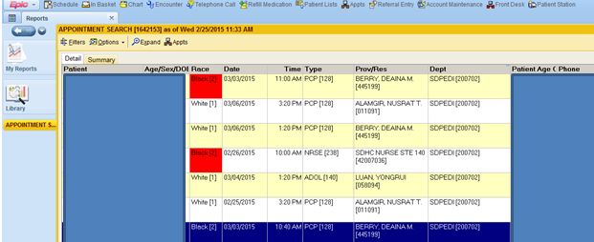
Second PDSA Cycle - Plan
Monitoring of monthly performance
Feb-March 2015- not improving fast enough
Parkland decided to launch a second PDSA cycle to further improve project outcome

Slide 43
Second PDSA Cycle - Do
Active brainstorming of project team, Quality Committee and research partners
Created a reporting structure able to identify those individuals (within the African American subset) in need of HPV vaccine
Designed a process to prioritize the visits in order to be as much impactful as possible:
      Identifying patients missing the last shot
      Focusing on girls under 13
Educated staff on the new reporting tools and processes

Slide 44
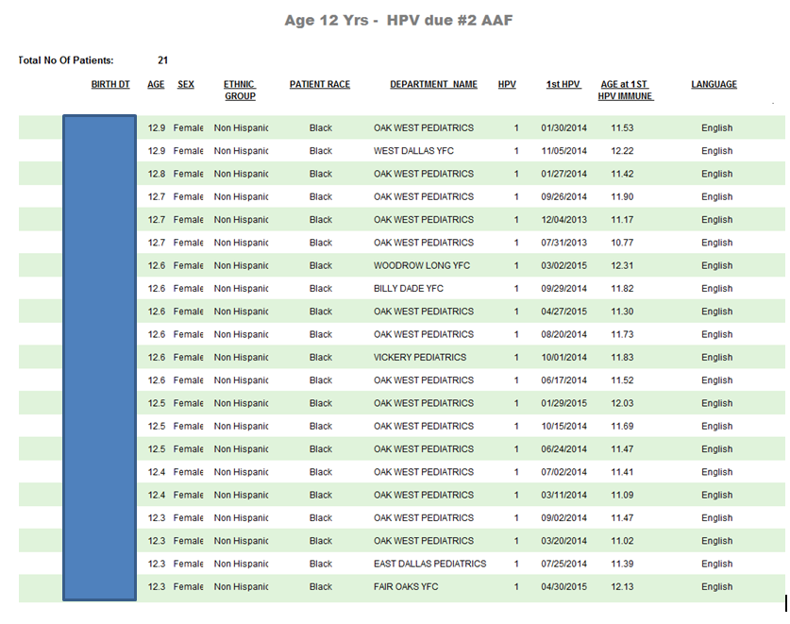
HPV Due Reports Example

Slide 45
Second PDSA Cycle - Study
Continuing monitoring the measure
Validating the performance and the due reports related to the complexity of the HPV series and cohort

Slide 46
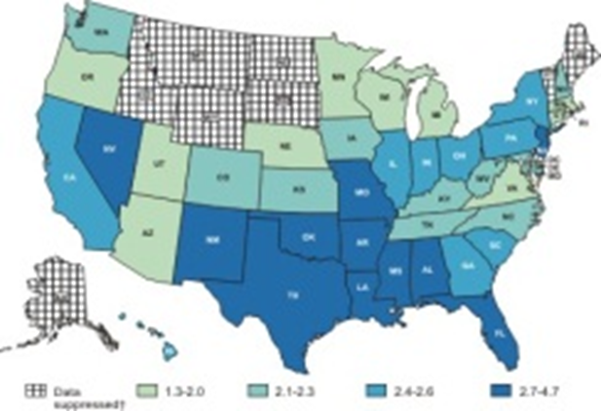
Second PDSA Cycle - Act
Further initiatives to improve the project outcome:
  Development and Implementation of “HPV Due Reports”
  Staff coordination and planning on use of HPV Due reports for targeted outreach to girls needing 2nd and 3rd doses
  Additional staff education on reports

Slide 47
Third PDSA Cycle - Plan
Monthly performance monitoring shows measure close to target, but vulnerable due to low number of girls in the denominator
Data shows that not enough girls accept the vaccine the first time
Two campaigns developed:
      Every Girl Counts - aggressive campaign to reach every single girl due for 3rd HPV
      Be Strong! Don’t Back Down! - scripting campaign to strengthen recommendation, increase acceptance of first dose and denominator

Slide 48
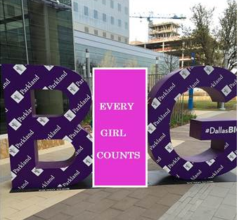
Third PDSA Cycle - Do
Clinic wide education on the “Every Girl Counts”
Providers initiate scripting
Daily email “message blasts”
Weekly Affirmation Messages

Slide 49
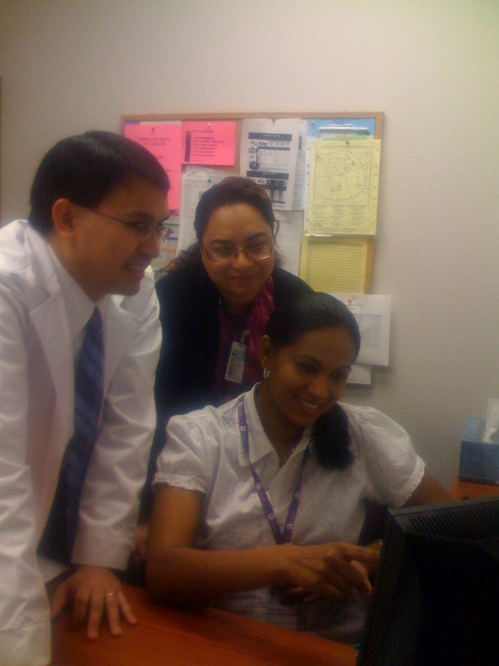
Third PDSA Cycle - Study
Weekly performance measurement
Increase schedule vigilance
Daily monitoring of schedules for HPV “no show visits” to take further action in scheduling and outreach

Slide 50


Third PDSA Cycle - Act

Slide 51
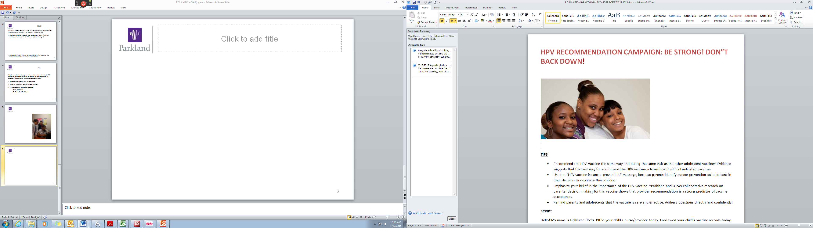
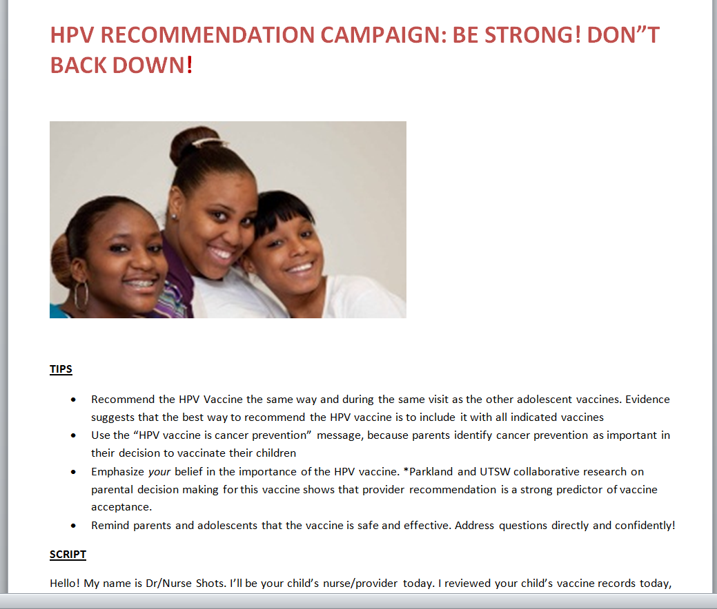
Third PDSA Cycle - Act

Slide 52
Current State
PDSA I
PDSA II
PDSA III

Slide 53
The Learning Board
Understand your measure well, keep validating the data if it doesn’t make sense. It took several cycles to understand the cohort, birthdates and rolling periods of numerator and denominator
Hard to achieve targets take multiple PDSA cycles
Keep at it, there is always something that can be done to improve results
Campaigns with energizing messages for a large and lofty goal gets widespread buy in, passion and results

Slide 54
JPS Behavioral Health Integration Model
Presented by: Chris Wall, RN-BC, BSN
Behavioral Health Project Director
August 5, 2015

Slide 55
JPS Behavioral Health Integration Model
Information Sharing
Monthly Information Packets
Integrated Planning
Shared care plan
Bi-Directional Screening
PHQ-9
Integrated Service Delivery
Group Visits
Best Practice Advisories
Evidence based library
Face-to-Face CME’s
Multidisciplinary Case Conference
SBIRT
Tobacco Use
HbA1c
LDL
Virtual Psychiatric and Clinical Guidance
Diabetes Education Classes
Shared Patient Lists
Embedded BH Specialists
Practice Agreements

Slide 56






Plan – Cycle 1
Adopt standardized depression screening tool across the network
Train staff on how to use screening
Work with IT to develop the screening tool within the ERM
Pilot the tool at select sites for “soft” go-live
Create Report to gather data on screening
Monitory and share results to inform quality improvement

Slide 57
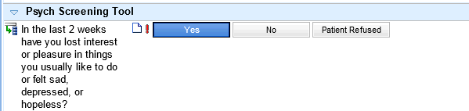
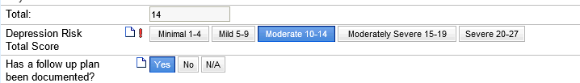
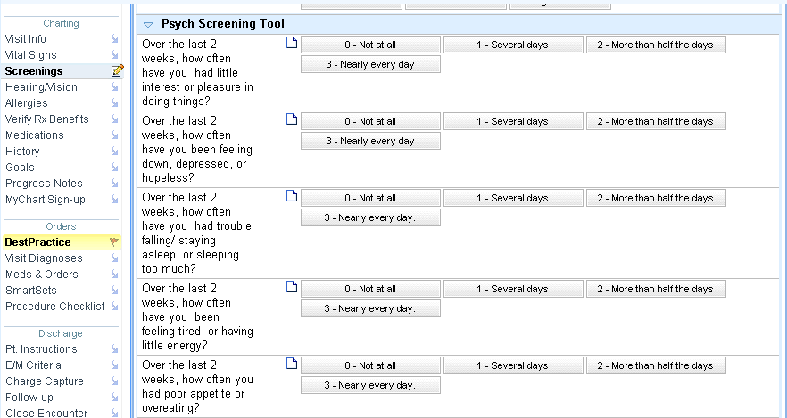
Do – Cycle 1

Slide 58

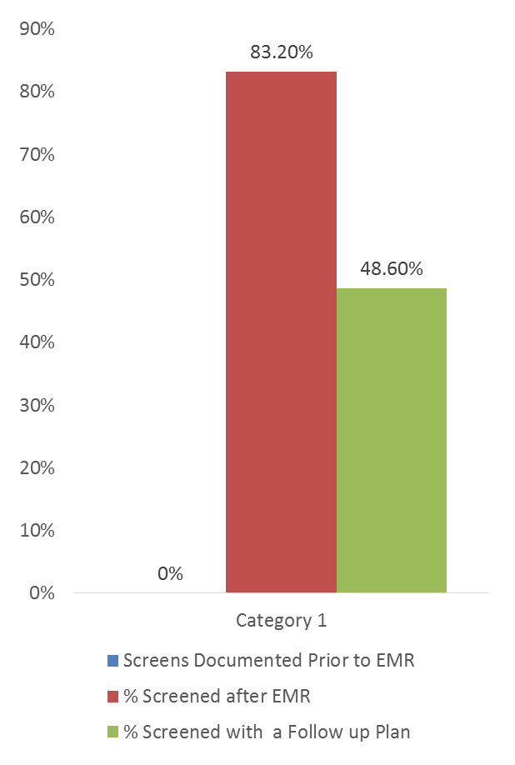
Study – Cycle 1
No Standardized Tool
Different Providers had different processes to identify depression
Once the PHQ-9 was live in the EMR, there were gaps in documentation for follow up

Slide 59
Plan – Cycle 2
Standardize screening administration and follow-up processes across primary care practices
Train staff on how to use screening and how to escalate and educate PCPs with evidence based treatment guidelines
Work with IT to develop “hard stops” and prompts for staff and providers
Automate alerts in EMR prompting providers to screen patients at routine intervals
Monitory and share results to inform quality improvement

Slide 60
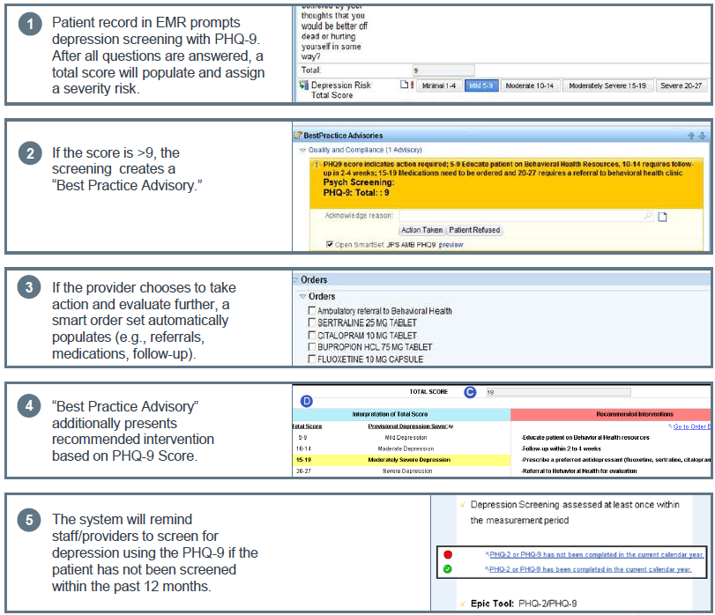
Do – Cycle 2
© 2015 Epic Systems Corporation. Used with permission.

Slide 61

Study – Cycle 2
Staff trained on screening tool
Automated alert in EMR prompts providers to document follow-up plan for scores > 9
Results monitored

Slide 62
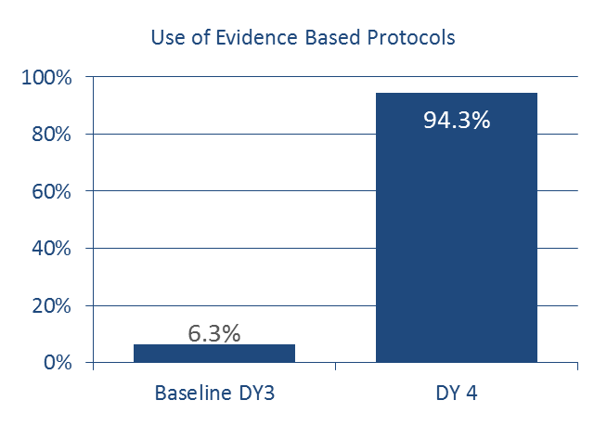
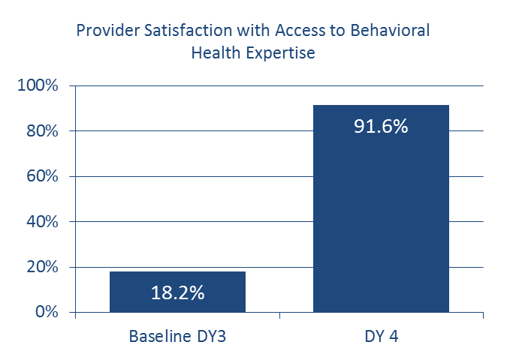
Study – Cycle 2
Primary care providers can speak with a psychiatrist about evidence based and best practice medication algorithms within 30 minutes.

Slide 63
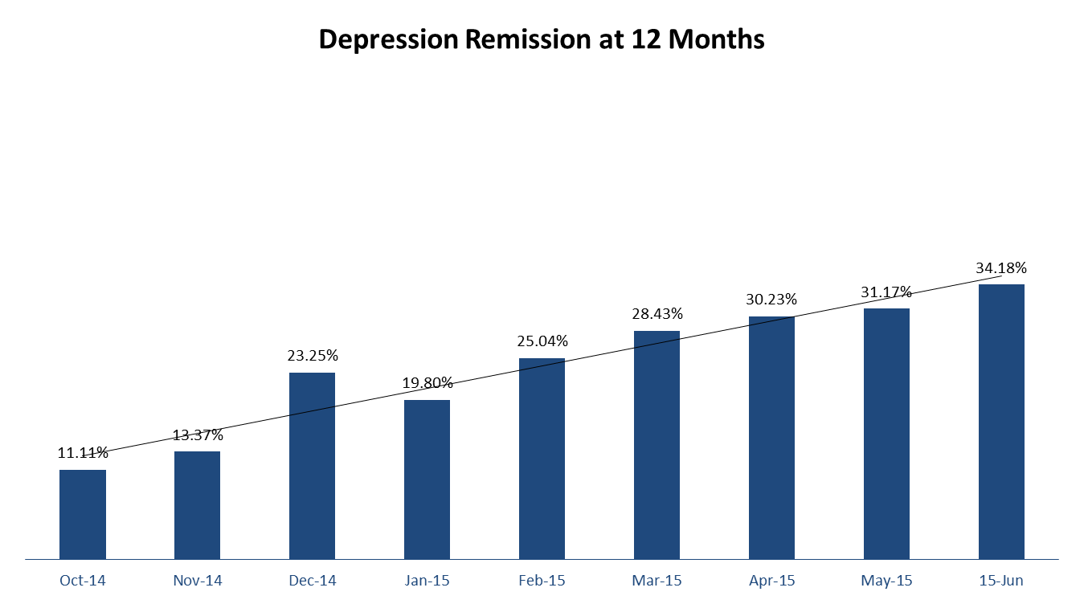
Study – Cycle 2

Slide 64

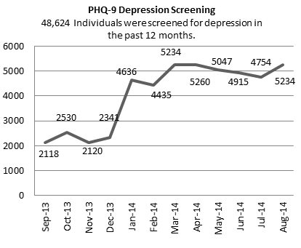
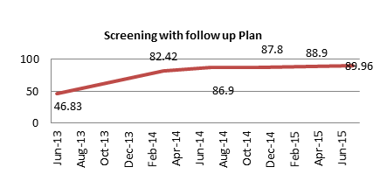
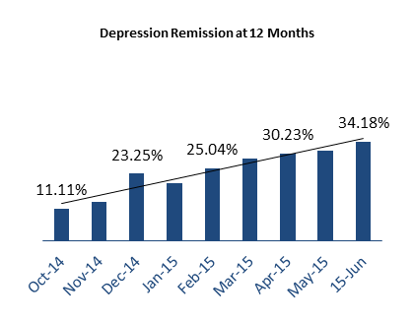
PDSA Story Board
Why is depression screening in Primary Care Important?
The majority of individuals with depression go unrecognized in the primary care setting which make up 15% of the total Primary Care Population.
The Patient Health Questionnaire (PHQ-9) is a validated and standardized tool with objective criteria for measuring risk of depression and diagnostic criteria.
JPS does not have a standardized tool or process to screen individuals for depression.
Screening for depression in primary care can lead to earlier detection and intervention, which can prevent exacerbation of depressive symptoms.
38,000 suicides occur in the U.S. annually. Up to 76% of those individuals had contact with their Primary Care provider the month prior.
The majority of individuals recognized with depression in primary care were recognized through a chief complaint by the patient once symptoms had had become worse.
PLAN
Project planning with stakeholder groups (Physicians, staff, management, IT , Pharmacy, etc.)
Identify appropriate screening tool and implement in the EMR
Develop reports to monitor and track results for depression screening.
Pilot screening tool and complete PDSA cycles.
Monitor results and improve process for depression screening.
STUDY
Develop and implement depression screening within primary care.
Results: The PHQ-9 was created within the EMR and is available to all primary care clinics.
The PHQ-9 was implemented within the normal workflow of clinic staff to be completed upon arrival.
Develop reports to monitor and track results for depression screening.
Results: 2 reports were created.
  Total number of individuals screened for depression and severity.
  Total number of individuals with a PHQ-9 score >9 who have a documented follow up plan.
Pilot Screening tool in 3 locations and complete PDSA cycles.
Results: Rapid cycle improvements were completed during the pilot of the tool at the 3 locations.
  Only 46.83% of individuals with a PHQ-9 >9 have a documented follow up plan.
  EMR is able to automatically score the PHQ-9 after it is completed.
  Within the first 30 days of us, over 7,000 individuals were screened for depression.
ACT
Depression screening was implemented to improve the patient outcomes related to early detection and intervention. Next steps include :
Expanding the process network wide to all primary care clinics within JPS Health Network.
Create “Best Practice Advisory” as a hard stop to prompt physicians to document a follow up plan on individuals who have a PHQ-9 >9
Expanding depression screening throughout the network:
Training staff how to utilize screening and when to escalate to a physician
Monitor results and share with primary care teams.
Provided treatment guidelines and education to PCPs
Create “Best Practice Advisory” :
A best practice advisory was created to prompt providers to document a follow up plan on individuals with a PHQ-9 >9
Screening with Follow up plan documented has increased from 46.83% - 86.9%
DO
Develop and implement depression screening within primary care.
Aim: Efficient and reliable screening process to screen for depression within primary care.
Adopt and implement PHQ-9 into EMR
Develop reports to monitor and track results for depression screening.
Aim: Create reliable reports with data to monitor progress and drive improvement.
Meet with IT and Knowledge Management to develop reporting specifications and create reports.
Pilot screening tool in 3 locations and complete PDSA cycles.
Aim: Reliable and seamless screening process that can be implemented network wide within primary care.
Collaborate with primary care teams at the 3 locations .
Train staff and continue rapid cycle improvements.
Aims
Develop and implement a standardized depression screening tool within the primary care setting.
Increase the number of individuals screened within primary care using a standardized tool to 2500.
Increase the number of individuals with depression screening and follow up plan documented.
Evaluating the Issue
No data was available to understand this problem originally.
There was no standardized screening tool or process to detect individuals who may have depression in primary care.

Slide 65
PDSA Thoughts to Ponder…
Important to Remember
Keys to Success
It often takes more than one cycle to achieve your objective.
By changing only 1 thing at a time you know the impact of your change.
Sometimes several changes are necessary to maximize the improvement you seek.
Be clear about your target objective
Make sure all participants are implementing the change as planned
Implement the change in a small portion of the agency
Study the results data before making a modification to the plan
Do not hesitate to start a new cycle when the data indicates or the team is convinced that a modification will improve results

Slide 66
And last…
Keep measuring and studying the results until you reach your objective and determine you have improved as much as you can.

Slide 67
Thank You
Next PDSA “Raise the Floor” Webinar:
TBD

